Slide 1
The Rise of Dictators
Causes of WWII

Slide 2
What?
A dictator is a ruler with total power over a country, typically one who has obtained control by force.
After the economic troubles and political unrest, the idea of fascism began to develop

Slide 3
What?
This ideology was violently nationalist, racist, anti-communist, anti-socialist and anti-democratic.
https://www.youtube.com/watch?v=aUcYU95kCAI (watch)

Slide 4

Where?

Slide 5
Where?
Significant fascist movements arose in the inter-war years in many European countries, including Italy, Austria, Hungary, Finland, France, Belgium, Spain, Romania and Britain. There were also fascist or extreme right movements in the United States and Australia.

Slide 6
Why?
This extremist movement arose from the deep social divisions that followed World War I, but it gained most backing during the Depression years of the early 1930s

Slide 7
Causes
The treaty of Versailles left the German people very upset with the deal they were given, and they held the government to blame. This created the opportunity for fascist dictators to take power
The Great Depression caused mass unemployment, poverty and misery around the world and the rise of fascism.

Slide 8
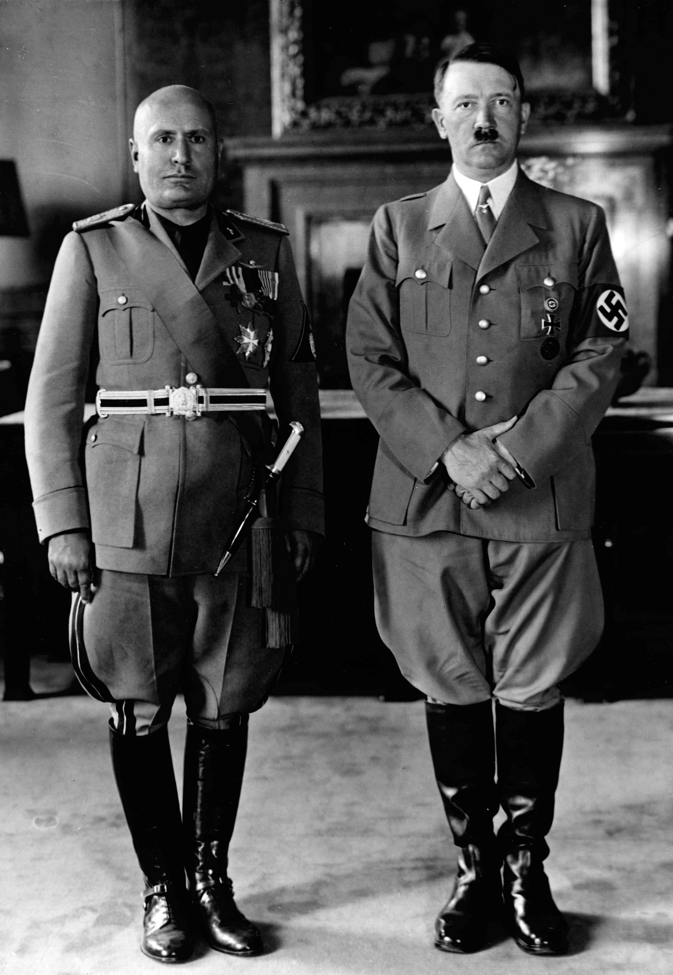
Who?
Benito
Mussolin
Adolf
Hitler
Benito Mussolini was an Italian political leader who became the fascist dictator of Italy from 1925 to 1945. Mussolini's main goal
was to rule an empire that was the heir of the Roman Empire.
Adolf Hitler was an Austrian-born German politician who was the dictator of Germany from 1933 until his death in 1945. He rose to power as the leader of the Nazi Party. Aimed to eliminate Europe's Jews and other perceived enemies of Nazi Germany.

Slide 9

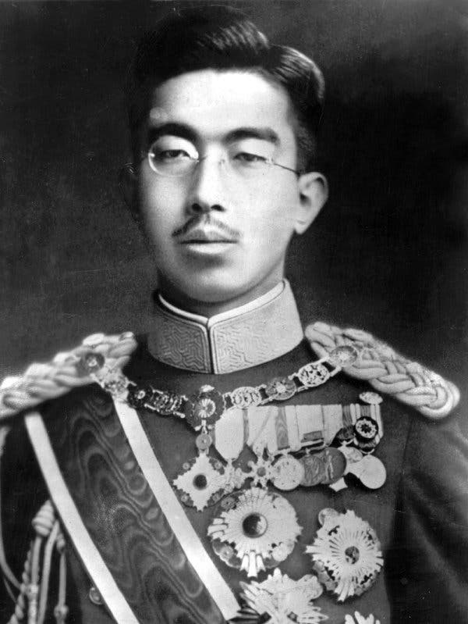
Hirohito – Emperor of Japan
The face of a military dictatorship.
Hirohito presided over the invasion of China, the bombing of Pearl Harbor, and eventually, the Japanese surrender to the Allies.

Slide 10

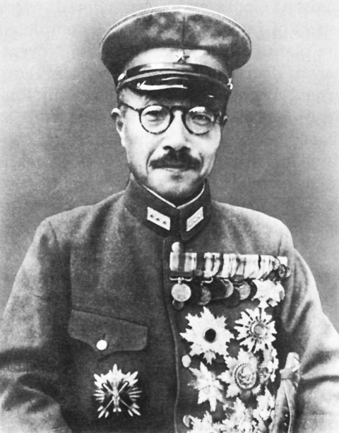
Tôjô Hideki
A general in the Imperial Japanese Army who served as Japan's prime minister from 1941 to 1944. He vocally supported Japanese expansion and a pre-emptive attack on the US and European colonial powers.

Slide 11
https://www.youtube.com/watch?v=KsBG34TSJJ4

Slide 12
Effect
Led to the rise of Hitler and the National Socialist Party
The National Socialist Party: Hitler’s political platform claimed that Germany must rid itself of its ‘impure elements’ in order to restore its strength
Even more than restoring the German economy, Hitler sought to reshape German identity – this ultimately led to WW2 and the Holocaust
There are many more effects that we will continue to discuss!

Slide 13
Significance
The rise of dictators in Europe had a profound impact on the world order. Fascist leaders promised their citizens prosperity through aggression. Militarism relieved psychological depression by promising world domination and power as well was economic relief by employing millions in the production of weaponry.
Hitler invaded Poland and set off World War II.

Slide 14
Supporting Evidence
Use pages 639 – 642 of Jacaranda 10 to find some examples of supporting evidence to add to your graphic organisers.

